Slide 1
.
OPEATING SYSTEM
JUSTIN JOLLY
S2 CSE A
ROLL:NO-37

Slide 2
CONTENT
what is an operating system?
Common desktop operating systems
Functions
Types of operating system
History of OS
Reference
1

Slide 3
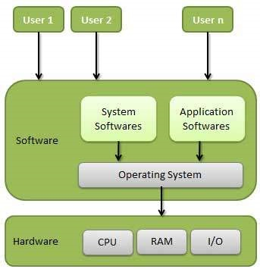
what is an operating system?
An Operating System (OS) is the software that communicates with the hardware and allows other programs to run.
.
2

Slide 4
It significantly affect how you interact with. It serves as a computers fundamental user interface ,with the device
3

Slide 5
Every computer, tablet, and smartphone includes an operating system that provides basic functionality for the device
4

Slide 6
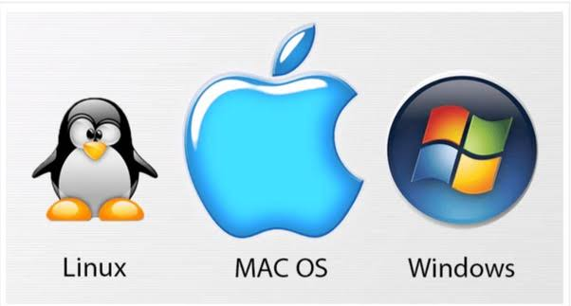
Common desktop Operating systems include
WINDOWS
LINUX
OS X (Apple)
5

Slide 7
FUNCTIONS
Manage the computer resources such as the CPU ,memory ,disk drivers and printers.
Establish a user interface.
Execute and provide services for applications software.
7

Slide 8
TPYES OF OPERATING SYSTEM
8

Slide 9
SINGLE –TASKING AND MULTI-TASKING
A single-tasking system can run one program at a time, while a multi-tasking operating system allows more than one program to be running in concurrency .
9

Slide 10
SINGLE-USER AND MULTI-USER Single-user operating systems have no facilities to distinguish users, but may allow multiple programs to run in tandem. A multi-user operating system extends the basic concept of multi-tasking with facilities that identify processes and resources, such as disk space, belonging to multiple users,
10

Slide 11
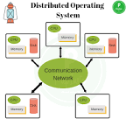
DISTRIBUTED A distributed operating system manages a group of distinct, networked computers and makes them appear to be a single computer, as all computations are distributed
11

Slide 12
TEMPLTED In the distributed and cloud computing context of an OS, templating refers to creating a single virtual machine image as a guest operating system, then saving it as a tool for multiple running virtual machines.
12

Slide 13
REAL-TIME A real-time operating system is an operating system that guarantees to process events or data by a specific moment in time.
13

Slide 14
History of OS
Operating systems were first developed in the late 1950s to manage tape storage
The General Motors Research Lab implemented the first OS in the early 1950s for their IBM 701
In the mid-1960s, operating systems started to use disks
In the late 1960s, the first version of the Unix OS was developed
The first OS built by Microsoft was DOS. It was built in 1981 by purchasing the 86-DOS software from a Seattle company
The present-day popular OS Windows first came to existence in 1985 when a GUI was created and paired with MS-DOS. 14

Slide 15
REFERENCE
https://en.wikipedia.org/wiki/Operating_system
https://www.tutorialspoint.com/operating_system/os_overview.htm
https://www.guru99.com/operating-system-tutorial.htm
14

